Slide 1


IP Portal Secure Login
By
Insured person
ESI Staff
Version 1.0

Slide 2

Agenda
1. Overview
4. Process Flow with Screenshots
2. Workflow Process for Insured Person Login
3. Workflow Process for ESI Staff Login

Slide 3
Overview

Slide 4
Overview
The purpose of this document is to give a complete description about the process that how a Bonafide IP can successfully signup and log-in through IP Portal to access personal details and avail online facilities available for IP.
ESIC has put security features in IP portal during login process for secured access & modification of IP personal data and to make transactions for various benefits provided.
Similarly, to access certain credentials of IPs, the ESI Staff shall also require secured access control to view contents.

Slide 5
Workflow Process for
IP Login by
Insured Person

Slide 6
Workflow Process for IP Login by Insured Person
Insured Person opens URL www.esic.in for IP Portal Login
IP can use Forgot Password button to Reset Password for Portal Login
IP clicks on Sign Up button to Set New Password for Portal Login
After successful login, IP can use Change Password option to change Password for Portal Login
IP logs in with Username, Password & Captcha in Portal.
IP can view employee /contribution details, entitlement for benefits, status of claims, and other value added services.

Slide 7
Process Flow with Screenshots for IP Portal Sign Up by Insured Person

Slide 8
Employer Portal → IP Portal

Slide 9
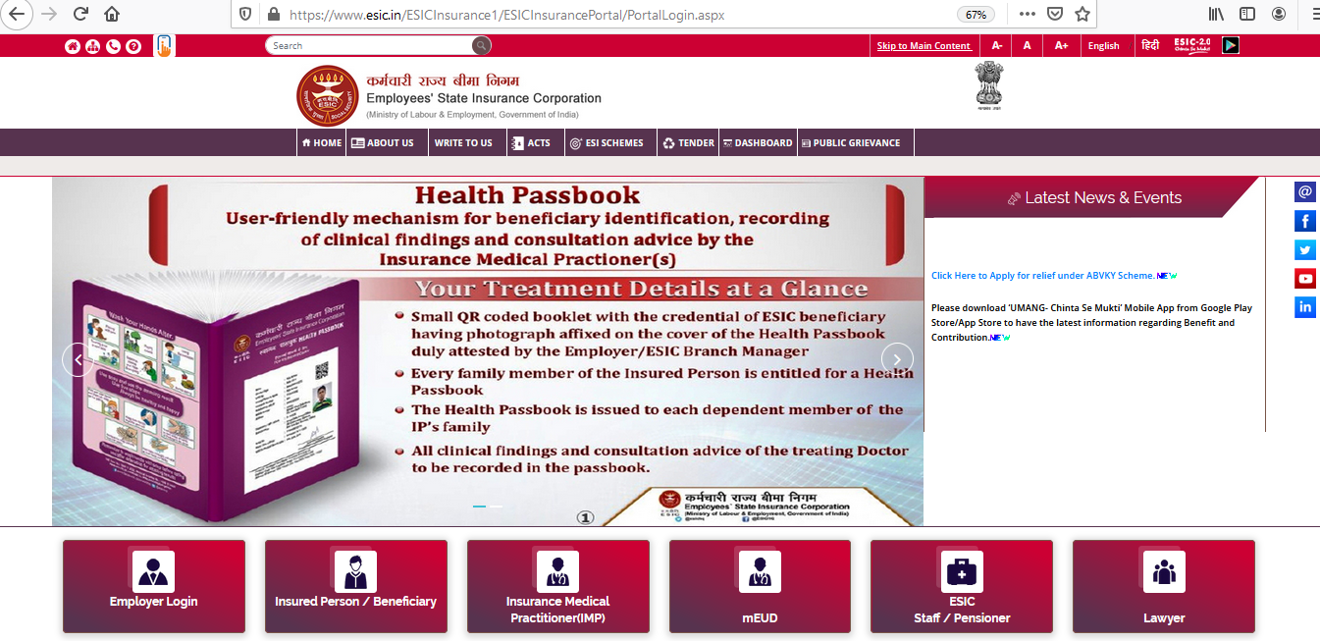
IP Portal Login through www.esic.in
Click on Insured Person/Beneficiary

Slide 10
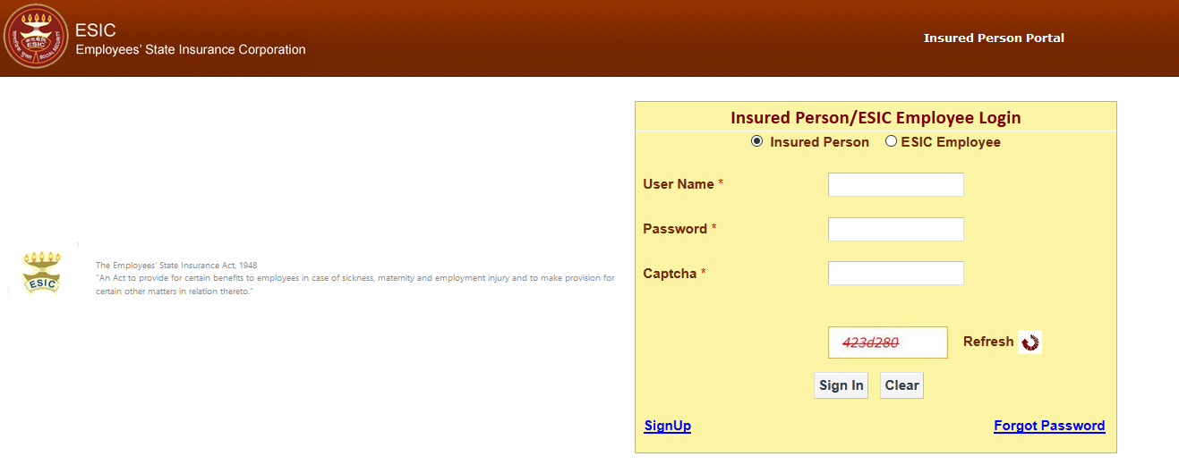
Sign Up process for IP
Click on Sign Up

Slide 11
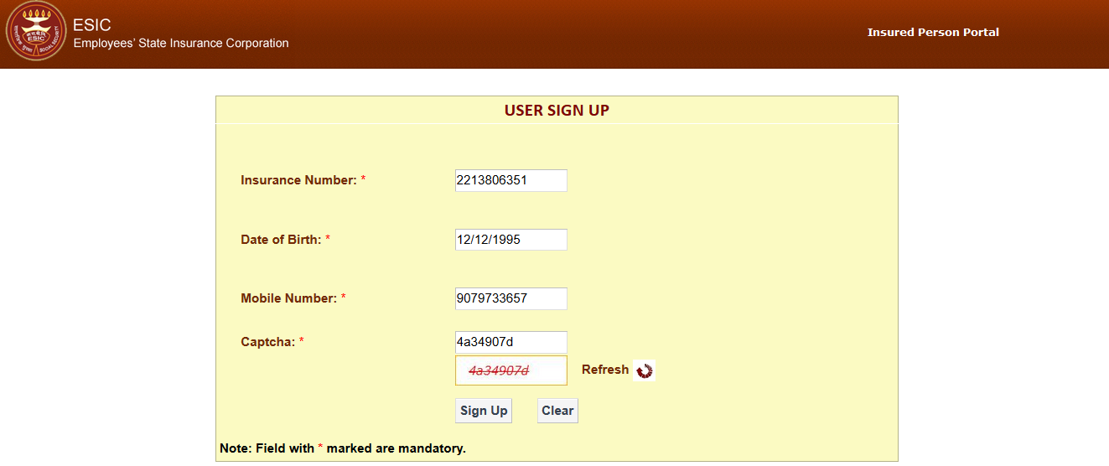
Sign Up process for IP
Enter valid Insurance Number
Select Date of Birth (as registered in ESIC Database through the Employer.)
Enter valid Mobile Number (as registered in ESIC Database through the Employer)
Enter Captcha
Click on Sign Up. The above details will be matched with ESIC Database

Slide 12
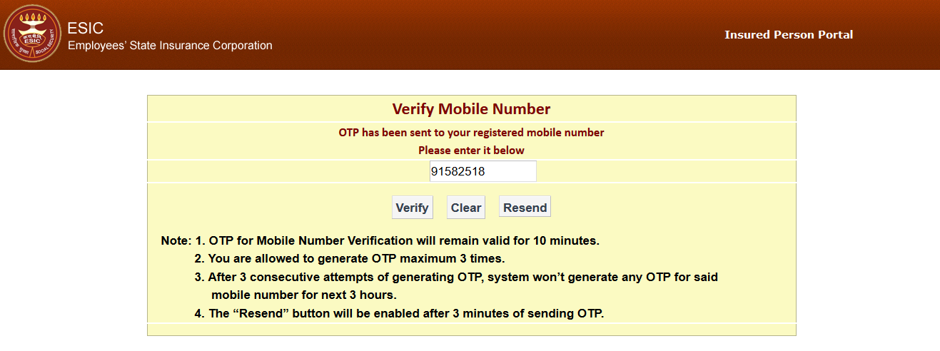
Sign Up process for IP
Enter OTP that has been sent to registered mobile number
Click on Verify

Slide 13
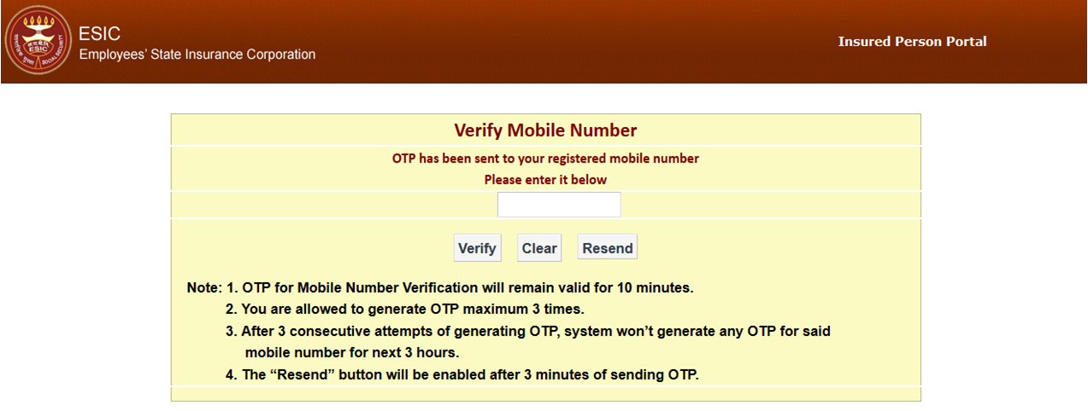
Sign Up process for IP
Resend button will be enabled after 3 minutes of sending OTP

Slide 14
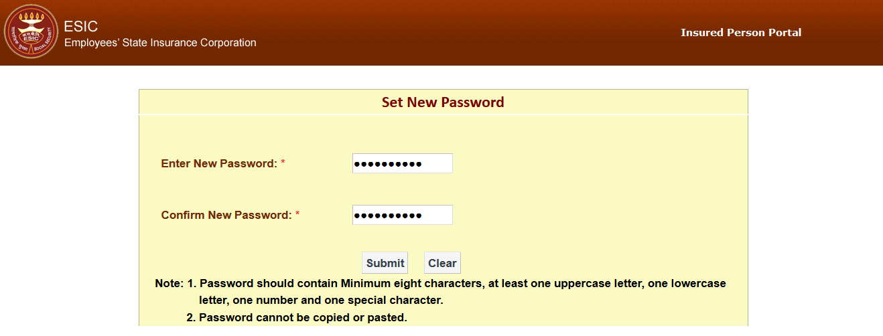
Sign Up process for IP
Enter New Password
Confirm New Password
Click on Submit

Slide 15
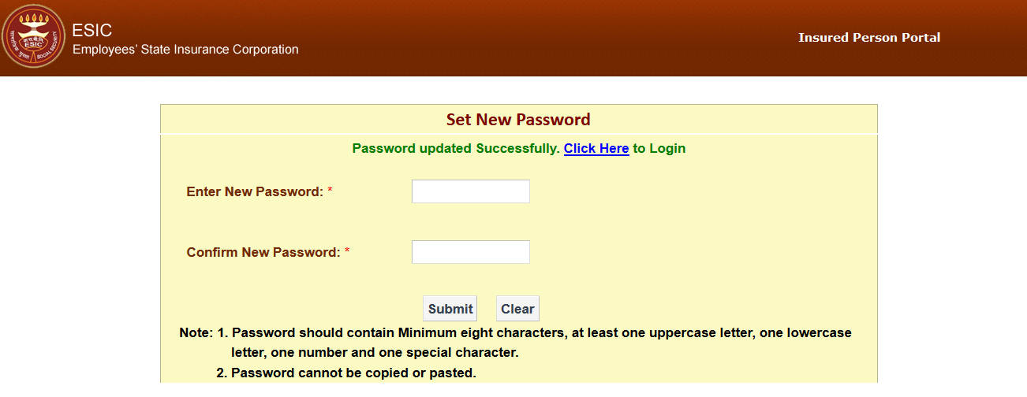
Password updated successfully
Your Password has been updated successfully. You may login with the new credentials (User ID and Password)

Slide 16
Process Flow with Screenshots
for IP Portal ‘Forgot Password’
by Insured Person to reset Password

Slide 17
Forget Password process for IP Login
Click on Forget Password

Slide 18
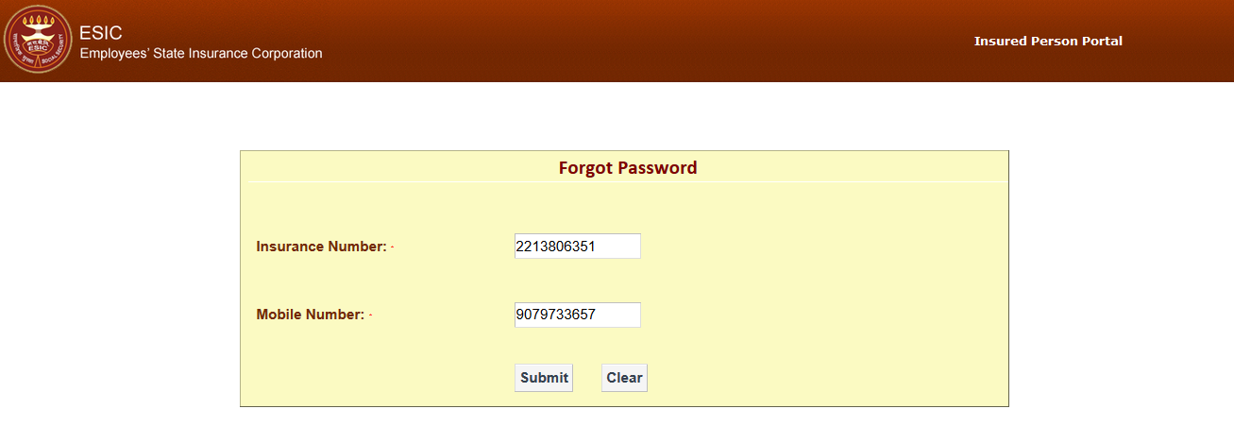
Forget Password process for IP Login
Enter Insurance Number
Enter valid Mobile Number registered in ESIC Database.
Click on Submit

Slide 19
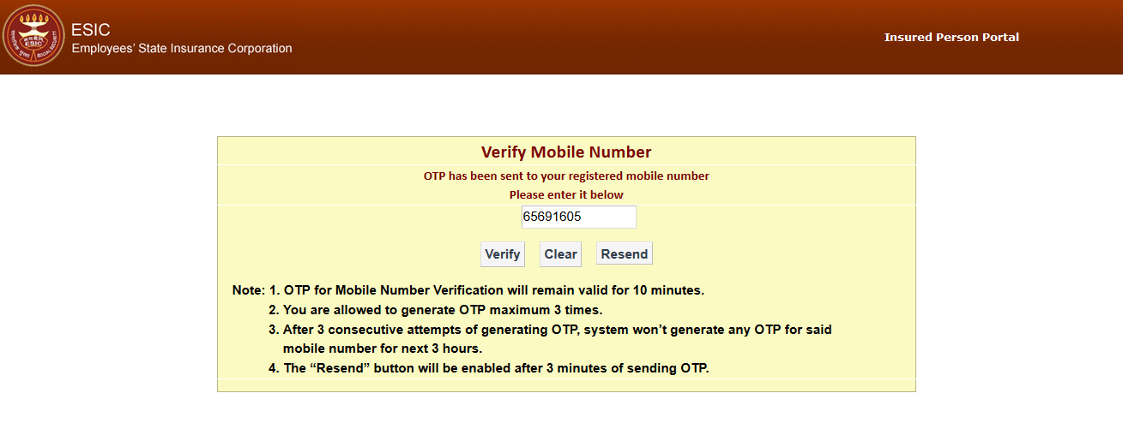
Forget Password process for IP Login
Enter OTP that has been sent to registered mobile number
Click on Verify

Slide 20
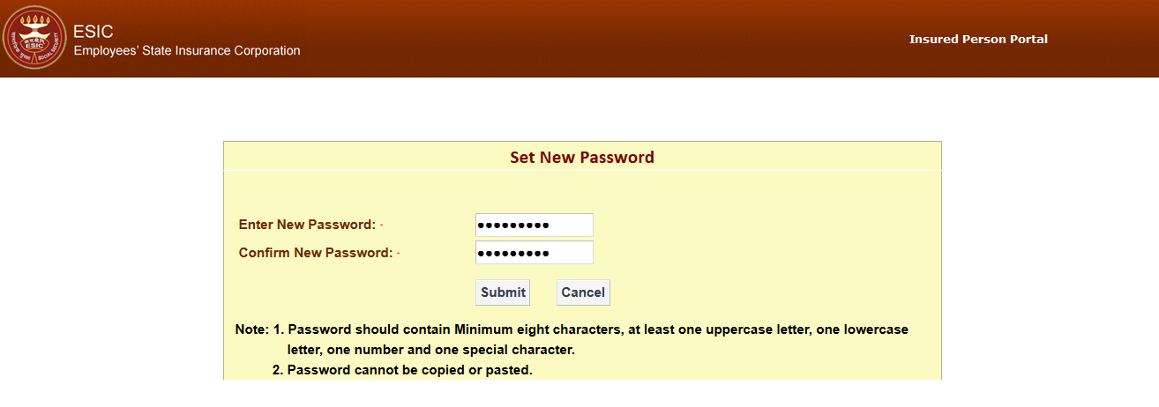
Forget Password process for IP Login
Enter New Password
Confirm New Password
Click on Submit

Slide 21
Password updated successfully

Slide 22
Process Flow with Screenshots for IP Portal Login by Insured Person

Slide 23
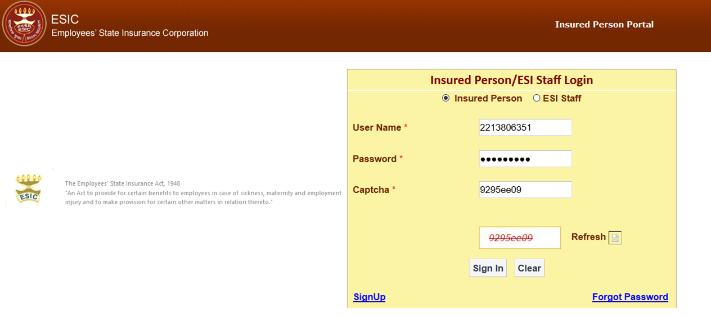
IP Portal Login
Enter IP number
Enter valid Password
Enter below mention Captcha
Click on Sign In

Slide 24
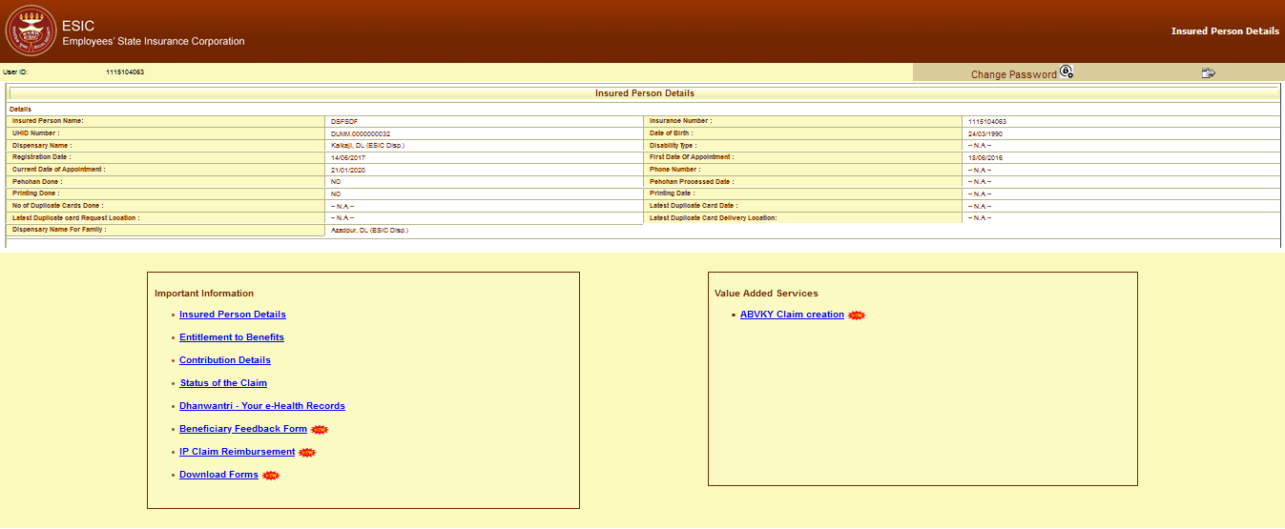
IP Login successfully

Slide 25
Process Flow with Screenshots for IP Portal Change Password by Insured Person

Slide 26
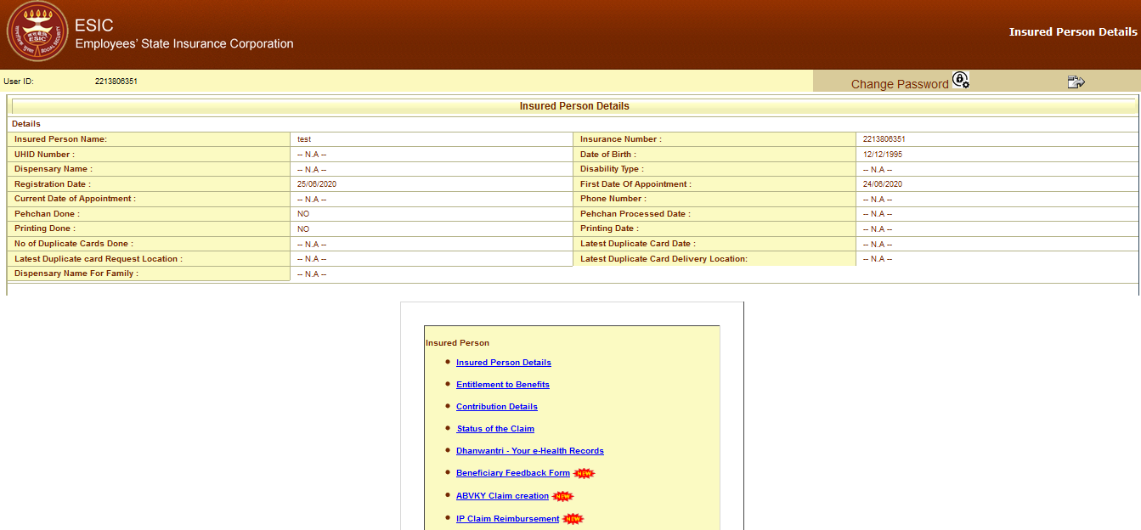
Change Password process for IP Login
Click on Change Password

Slide 27
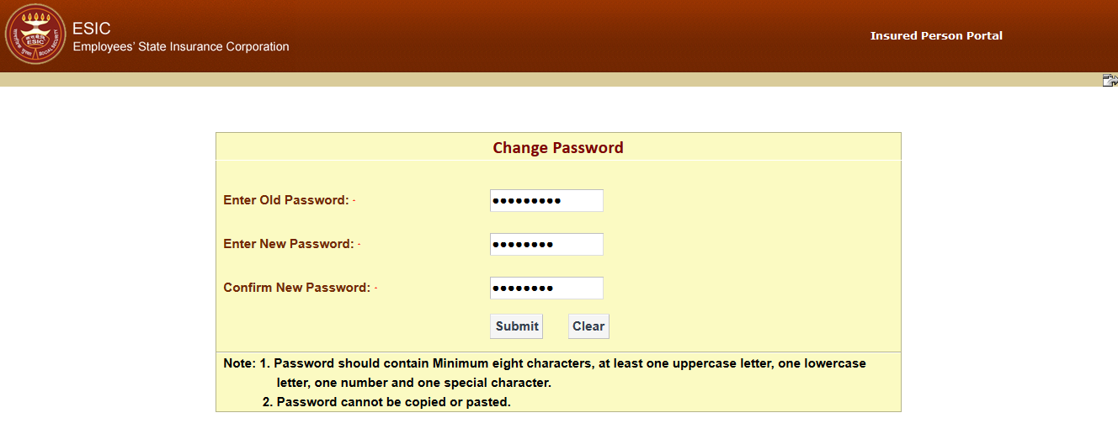
Change Password process for IP Login
Enter Old Password
Enter New Password
Confirm New Password
Click on Submit

Slide 28
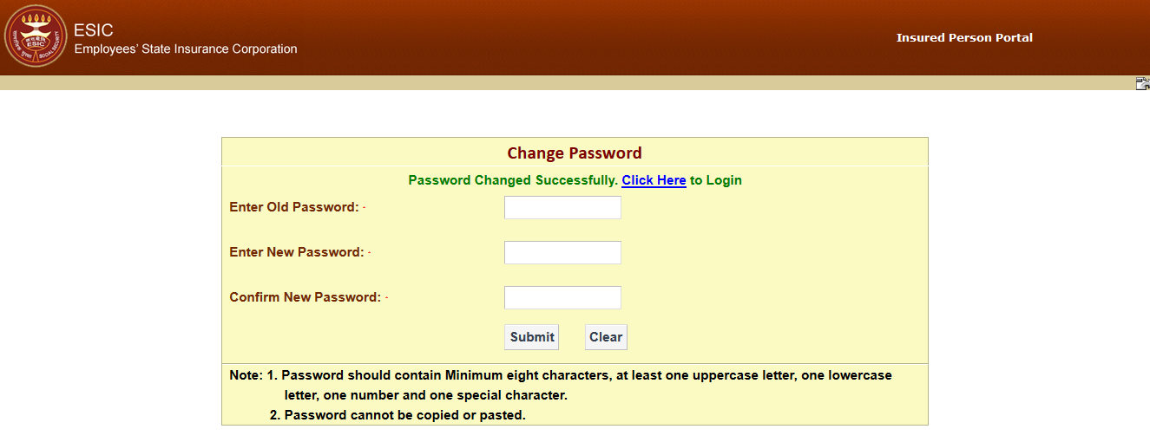
Password Changed Successfully

Slide 29
Workflow Process for IP Login by
ESI Staff

Slide 30
Workflow Process for IP Login by ESI Staff
ESI Staff open URL www.esic.in for IP Portal Login
ESI Staff enter Insurance Number to view employee/contribution details, entitlement to benefits, etc.
ESI Staff logs in with their existing User Id & Password (for Panchdeep Module access) for Portal Login

Slide 31
Process Flow with Screenshots for IP Portal Login by ESIC Staff

Slide 32
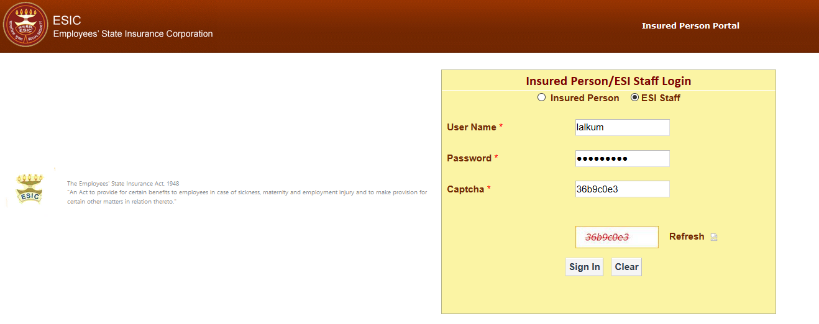
IP Portal Login by ESIC Staff
Enter User Name
Enter valid Password
Enter below mention Captcha
Click on Sign In

Slide 33
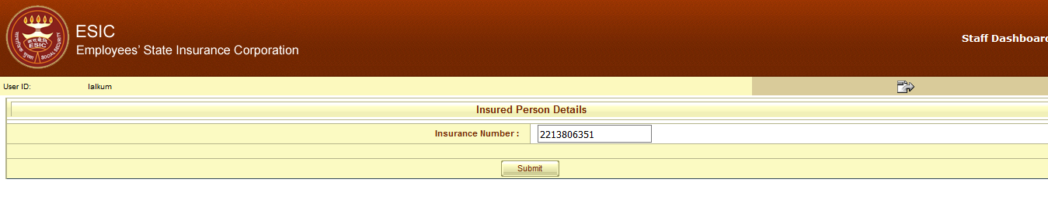
IP Portal Login by ESIC Staff
Enter Insurance Number
Click on Submit

Slide 34
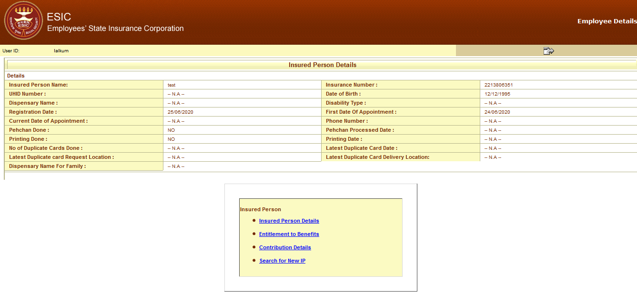
IP Portal successfully Login by ESIC Staff

Slide 35
Thank You

